Slide 1


Recommendation-Based
Digital Library System
Submitters:
Yuval Zohar
Amit Perets
Supervisor:
Dr Naomi Unkelos Shpigel
24-1-D-20
-1-

Slide 2

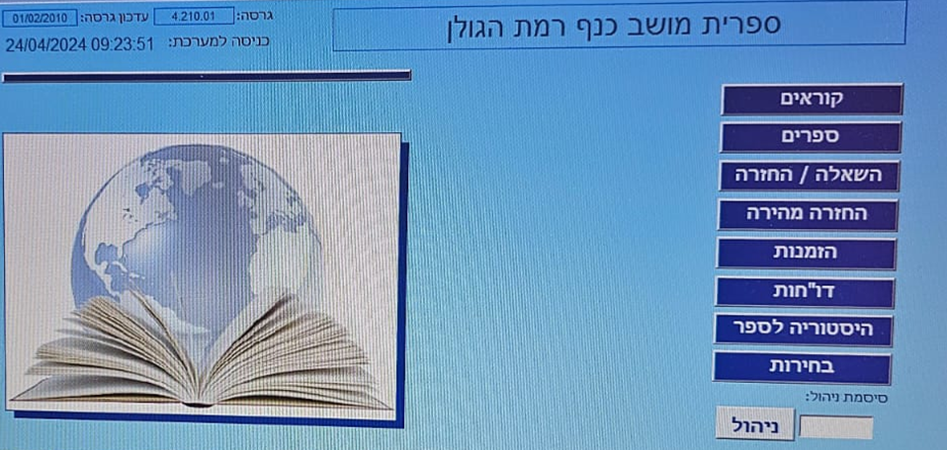
Nowadays
Limited Budgets
Outdated Technologies
Poor User Interfaces
Lack of Personalized Recommendations
-2-

Slide 3
Our solution
Utilization of modern technologies
Implementation of a user-friendly interface
Adaptation for those lacking technological knowledge
Exceptional user experience
Integration of a recommendation system
Free accessibility to both small and large libraries
-3-

Slide 4
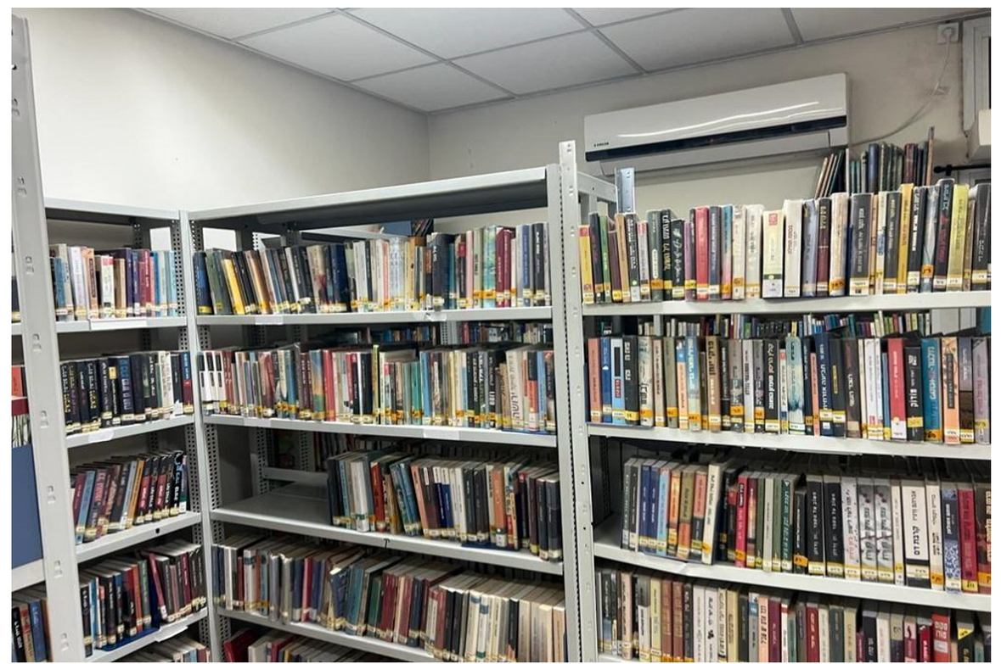
Requirments gathering
Interview with the library staff of Moshav Kanaf
Reviewed the current system and its limitations
Gathered requirements for the intended system
Received guidelines to support the development process
-4-

Slide 5
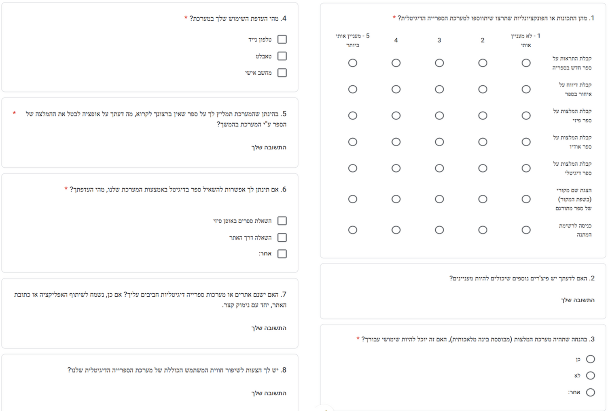
Requirments gathering
Survey for readers communities & potential readers
-5-

Slide 6
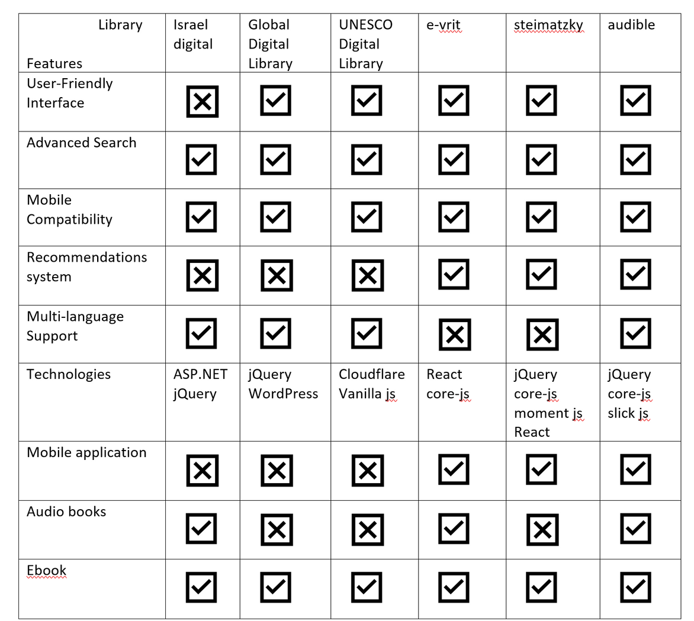
Literature Review
Comparison between 6 digital library systems across a variety of features and elements within them
-6-

Slide 7
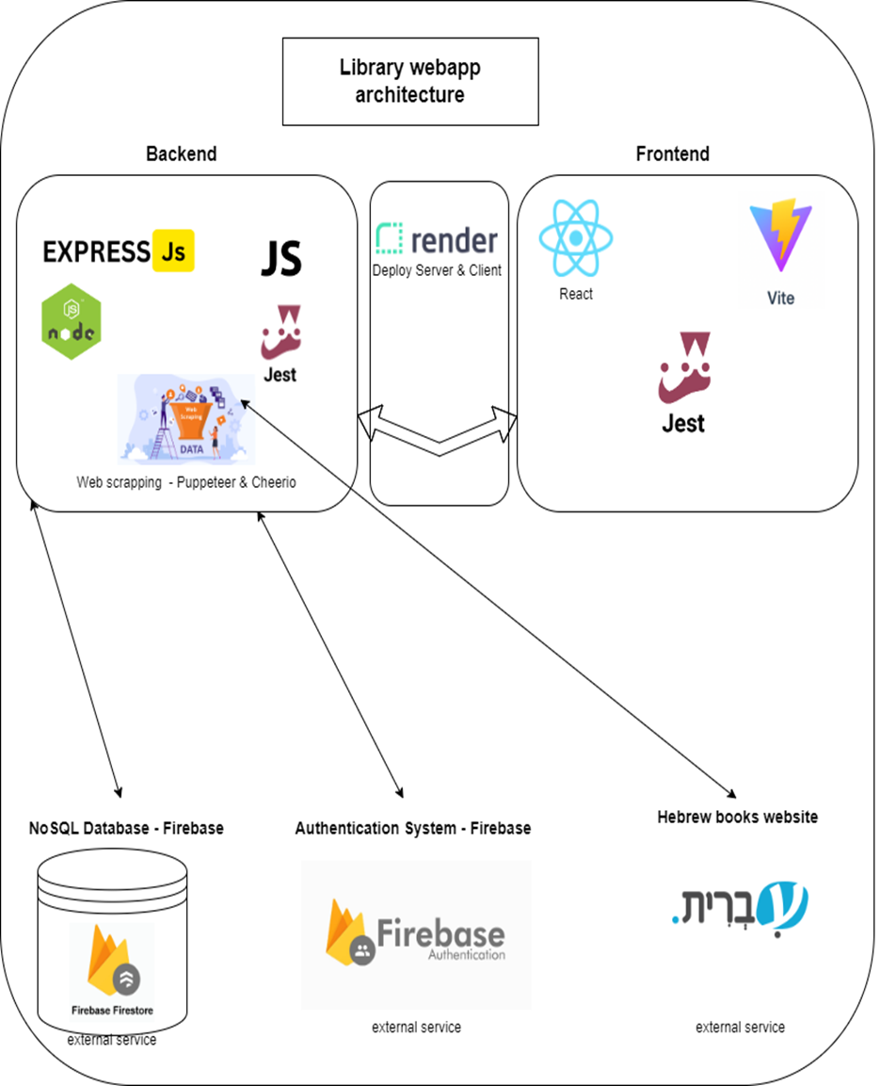
System architecture
-7-

Slide 8
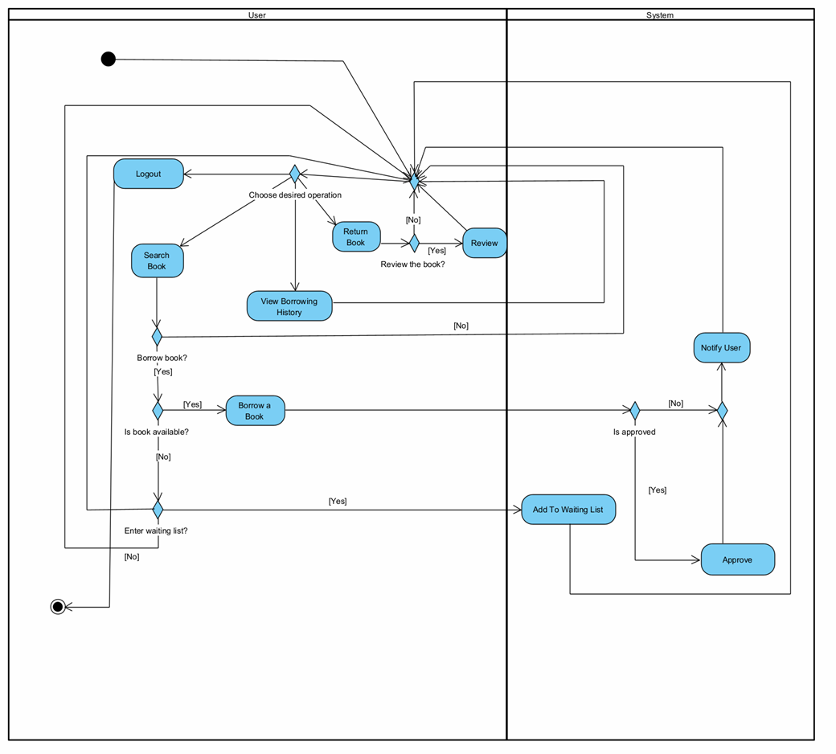
Activity diagram
-8-

Slide 9
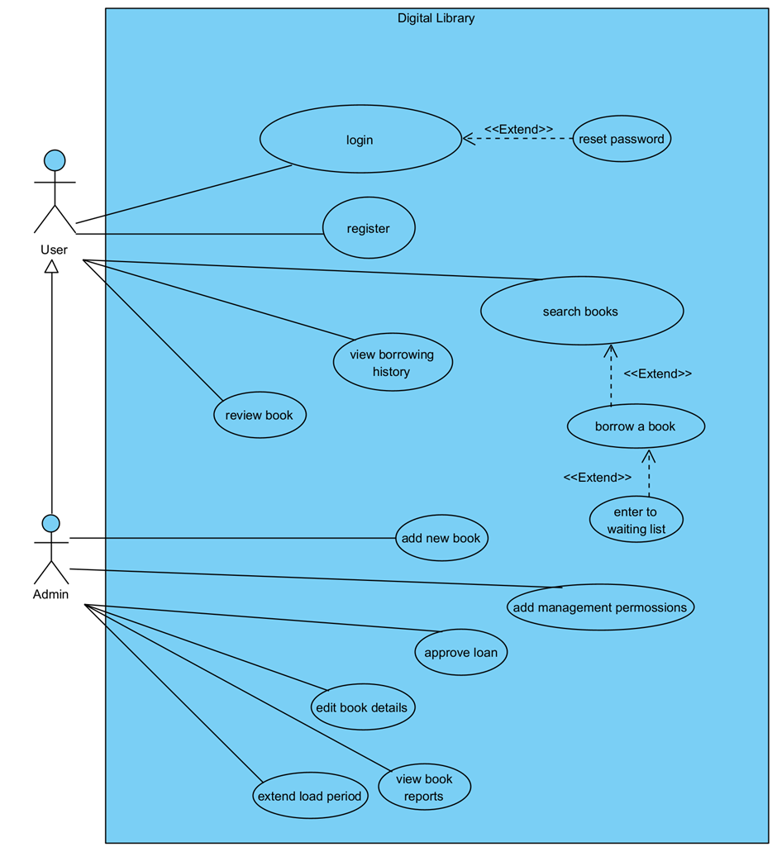
Use case diagram
-9-

Slide 10
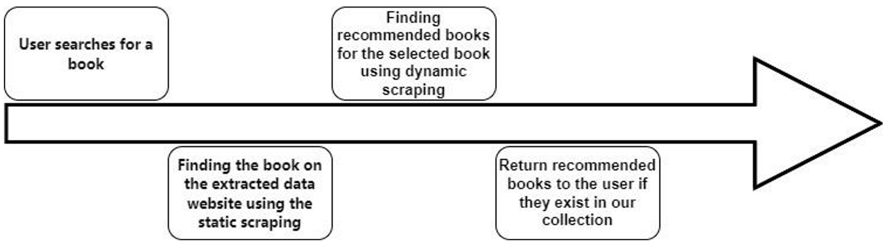
Algorithm - Web Scraping
Why not use AI directly?
Data!!
-10-

Slide 11
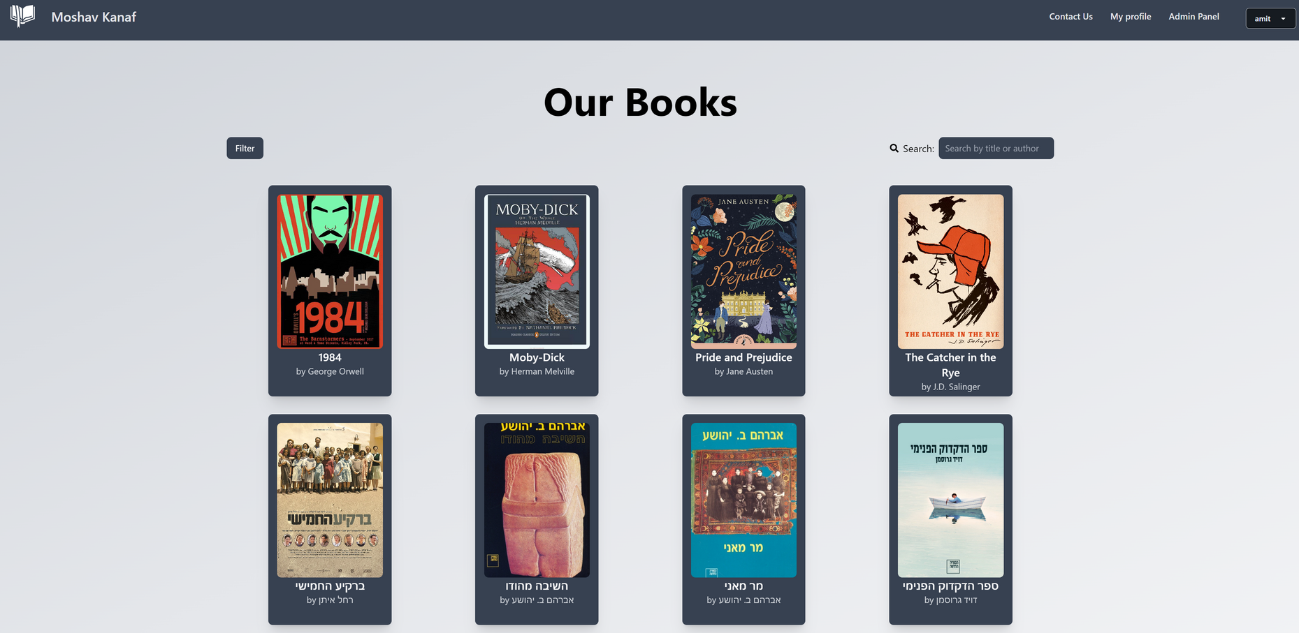
Prototype
Search books page
-11-

Slide 12
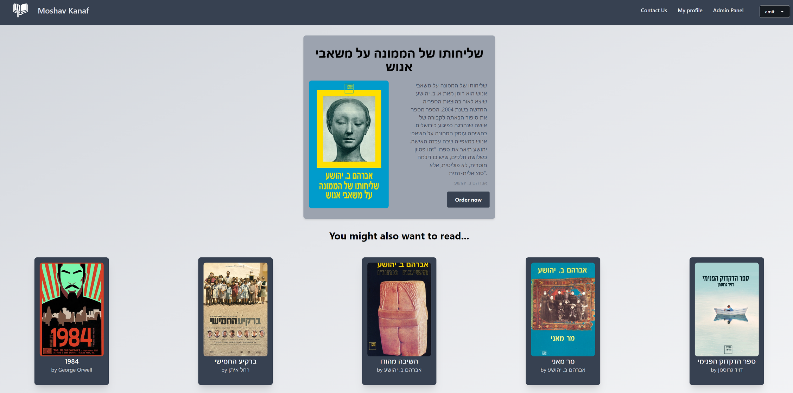
Order a book page
-12-

Slide 13
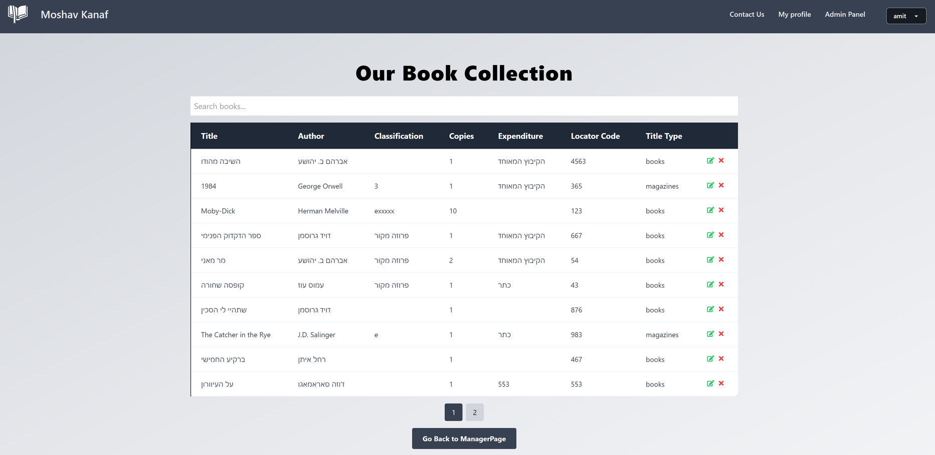
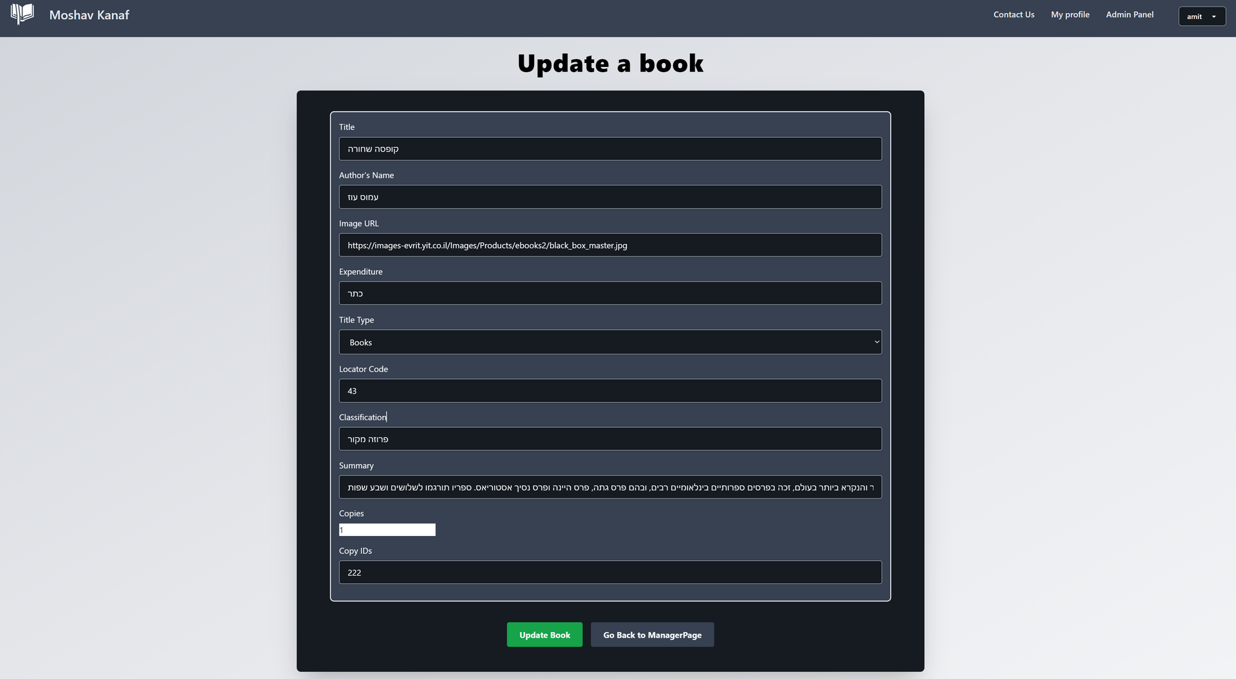
Admin panel pages
-13-

Slide 14
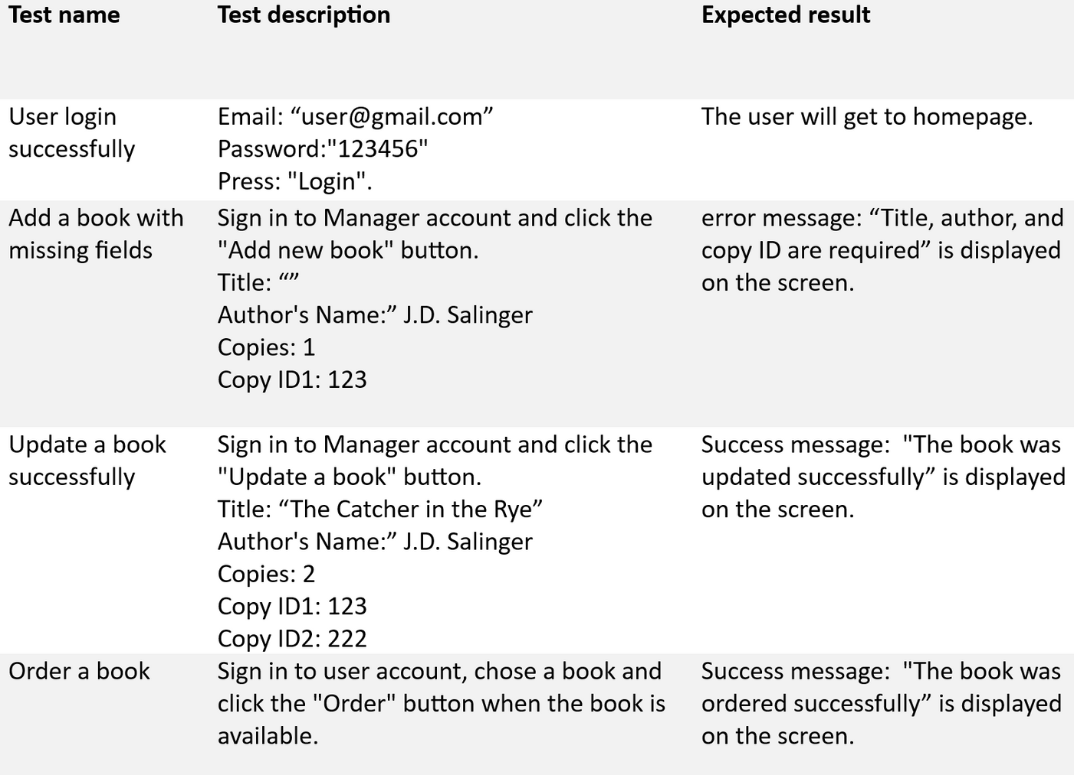
Tests
-14-

Slide 15
Thank You!
-15-

